Slide 1
Post COVID-19 Planning Prepared for North Sound BH-ASO
Dr. Glenn Lippman • May 2020

Slide 2
Purpose
Look at current models regarding Post-Pandemic Behavioral Health (BH) issues and needs
Information from other resources
Person specific concepts

Slide 3
Reactions & Behavioral Health Symptoms in Disasters: SAMHSA

Slide 4
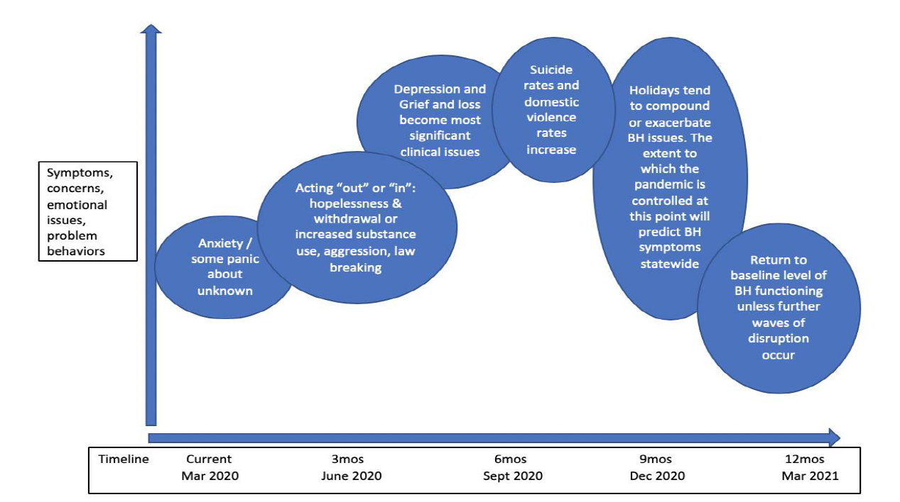
Forecasted Behavioral Health symptoms from COVID-19 Over Time

Slide 5
Other Influences
Stress levels of SARS survivors remained persistently elevated and higher than those of community control subjects 1 year after the SARS outbreak. (multiple SARS studies)
Although many individuals experiencing psychological distress or psychiatric disorder they may not seek formal help for their symptoms. BJP (2018)
Large scale disasters “are almost always accompanied by increases in depression, posttraumatic stress disorder (PTSD), substance use disorder, a broad range of other mental and behavioral disorders, domestic violence, and child abuse.” JAMA Internal (2020)
Preliminary prevalence and mortality estimates in multiple geographic areas, show a consistent pattern of racial/ethnic differences. JAMA Internal (May 2020)

Slide 6
Other Influences
(Continued)
Issues with STIGMA - Participants in several studies reported that others were treating them differently: avoiding them, withdrawing social invitations, treating them with fear and suspicion, and making critical comments. Lancet (2020)
Routine medical care is deferred:
There has been on average a 60% decrease from pre-pandemic levels in eight hospitals in the three regions that were assessed.
Urgent cancer referrals have dropped by an average of 76% compared to pre-pandemic levels in the three regions.
MMR down 40% and DipT down 22% from Feb to April.
Routine Cancer screenings are down over 50%

Slide 7
.
MMWR / May 8, 2020 / Vol. 69

Slide 8
Impact of Behavioral Health from the Economic Changes
Conclusions based on certain study populations and events (SARS, Katrina, 9/11) might not be generalizable to the wider public or present time. However, there are similarities to the impact from the 2007-2009 economic recession that provide additional “clues”.
From the Meadows Mental Health Policy Institute in Texas which is nationally known for being a leader in policy toward improving the care of people with mental illness

Slide 9
.
About just under 1000 people being lost for every 1% increase in unemployment; 780 is the number that was projected. Medscape, Stephen M. Strakowski, MD; Nassir Ghaemi, MD, MPH; Andy Keller, PhD May 08, 2020

Slide 10
Projecting about 100,000 additional cases of substance use disorders related to the recession, and the data shows the projected deaths due to drug overdoses- approximately 400 lost per 1%
Medscape, Stephen M. Strakowski, MD; Nassir Ghaemi, MD, MPH; Andy Keller, PhD May 08, 2020

Slide 11
Considerations
Those individuals we know
Those individuals we don’t know yet
Specific groups
Health Care Workers (HCW) and First Responders
Elderly
Medically compromised
Post COVID-19 Neuropsychiatric sequelae

Slide 12
Those we Know Those we Don’t Know Yet
People with pre-pandemic Mental Health Issues
Possible missed appointments, scripts, doses
Higher risks of Anxiety and PTSD like symptoms
Higher risks of SUD issues
Greater levels of isolation
Issues around lost supports
Children with parents returning to work while no school or aftercare, continued disruption in schedules and routine, fear, and erosion of prior gains in treatment or school settings.
People with pre and/or post Mental Health Issues
Unemployed
Under-employed
Family violence victims
New onset BH issues
SUD
Mental Health
Depression, anxiety, and PTSD related issues
Grief and Loss issues
Missed or delayed medical care
Development of distress reactions with associated exhibit health-risk behaviors, such as substance use, family conflict and insomnia.

Slide 13
Opportunities to Consider
Increase accessibility to follow up appointments
Increased roles for pharmacists, nurses, groups, peer supports
Proactive outreach (telephonic, text)
Continued expansion of tele-med and continued flexibility of its use
Increased availability of family, youth services along with family education around how children manifest reactions to such situations.
Implementation of Stepped care or for others an EAP model of services that are problem focused, time limited and based on measured outcomes
Collaboration with FQHC’s and PCP’s
Standardized screenings
Use of MH appointments to assess for missed medical care
2-1-1 service information to BH Crisis system
Collaboration with community safety net systems (Salvation Army, Boys/Girls Clubs, Red Cross, Food Banks, Financial Systems)
Extending outreach for additional delivery of Psychological First Aid or outreach*
Culturally adapted mental health services that address the inequitable distribution of services
Family education around Maximize awareness of existing telephone supports and life lifelines (such as national Disaster Distress Helpline).
°Cohen GH, Tamrakar S, Lowe S, et al, Comparison of simulated treatment and cost-effectiveness of a stepped care case-finding intervention vs usual care for posttraumatic stress disorder after a natural disaster. JAMA Psychiatry. 2017;74(12):1251-1258. doi:10.1001/jamapsychiatry. 2017.3037
*doi:10.1001/jamainternmed.2020.1562

Slide 14
Specific Sectors
Healthcare workers/First Responders
Elderly
COVID recovering persons
Address PTSD related issues (ongoing), stigma, anger and family issues. Surveillance
Proactive Outreach. Gatekeeper model (Care Manag J. 2013;14(1):11-20)
Monitoring for long term neuro-psychiatric sequelae of COVID

Slide 15
What We Don’t Know
Recurrences of COVID-19
Impact of vaccines – hopes and disappointments
Long term impact due to Social/healthcare inequities
Worsening impact of limited Economic recovery or slow down
Lack of Housing stability
Long terms impact on healthcare delivery system (especially in rural settings)
Long term impact of misinformation
And…. How accurate are any projections?

Slide 16
Final thoughts…
“We do have, I think, some time to ramp up and be ready. I would recommend, too, that we really look at primary care strategies, because if we don't expand detection and treatment more to primary care with partnerships with psychiatry—using things like collaborative care—we're just not going to have the bandwidth to be available”. Andrew Keller, PhD
We need to think about how we can grow and be stronger from this event. We need to be thinking about post-traumatic growth.
Andrew Penn, RN, MS, NP, CNS, APRN-BC

